Slide 1

Group 4
Goutham Vemula
Mridul Sankarakumar
Ashritha Reddy Devarampally
Akshit Arora
Lokesh Dondapati
Heny Vijaykumar Patel
DAV-6100- Information Architecture
Final Project

Slide 2



Agenda
Overview
About Data
Project Architecture
Demo
Reporting & Visualization
Research Questions
Team Responsibilities
Yeshiva University | Katz School

Slide 3
Project Overview
Problem Statement:
The New York City Department of Transportation wants to identify the key factors contributing to motor vehicle collisions in the city and develop targeted strategies to improve road safety. By analyzing the historical crash data, the department aims to gain insights into the common causes, locations, and patterns of collisions, enabling them to make data-driven decisions for implementing effective interventions and allocating resources efficiently. The ultimate goal is to reduce the number of crashes, injuries, and fatalities on New York City's streets, creating a safer environment for all road users.
Yeshiva University | Katz School

Slide 4
About Data
The Motor Vehicle Collisions database in New York City meticulously documents comprehensive information on all motor vehicle accidents reported to the police. It mandates the completion of detailed reports for incidents involving injuries, fatalities, or property damage exceeding $1000. This repository encompasses a wide array of data points, including vehicle specifics, personal details of involved individuals (drivers, passengers, pedestrians, etc.), and overarching characteristics of the crash event. Dating back to April 2016 when the electronic reporting system was adopted, this dataset stands as a crucial asset for analyzing collision causes, evaluating traffic safety policies, and formulating proactive measures to enhance road safety.
Data Source : https://data.cityofnewyork.us/Public-Safety/Motor-Vehicle-Collisions-Vehicles/bm4k-52h4/about_data
Yeshiva University | Katz School

Slide 5
Crashes Dataset: The Crashes dataset contains information about motor vehicle collisions reported by the New York City Police Department (NYPD). Each row in the dataset represents a unique collision event. The dataset includes details such as the date and time of the crash, location (borough, zip code, latitude, longitude), street names, number of persons injured or killed (including pedestrians, cyclists, and motorists), contributing factors, and vehicle types involved. This dataset serves as the primary source for analyzing collision patterns, identifying high-risk locations, and understanding the overall impact of collisions on road safety.
Vehicles Dataset: The Vehicles dataset provides additional details about the vehicles involved in each collision. It is linked to the Crashes dataset through the unique collision ID. Each row in the dataset represents a vehicle involved in a crash. The dataset includes information such as the vehicle type, make, model, year, registration state, damage details, and contributing factors specific to each vehicle. This dataset allows for a deeper analysis of the types of vehicles involved in collisions, their characteristics, and potential contributing factors related to vehicle design or maintenance.
Person Dataset: The Person dataset contains information about individuals involved in motor vehicle collisions, including drivers, passengers, pedestrians, and cyclists. It is linked to the Crashes dataset through the unique collision ID. Each row in the dataset represents a person involved in a crash. The dataset includes details such as the person's role (driver, passenger, pedestrian, cyclist), injury severity, age, gender, position in the vehicle, safety equipment used, and contributing factors specific to each individual. This dataset enables the analysis of demographic patterns, injury outcomes, and factors contributing to collisions from the perspective of the individuals involved.
Summary of Datasets

Slide 6
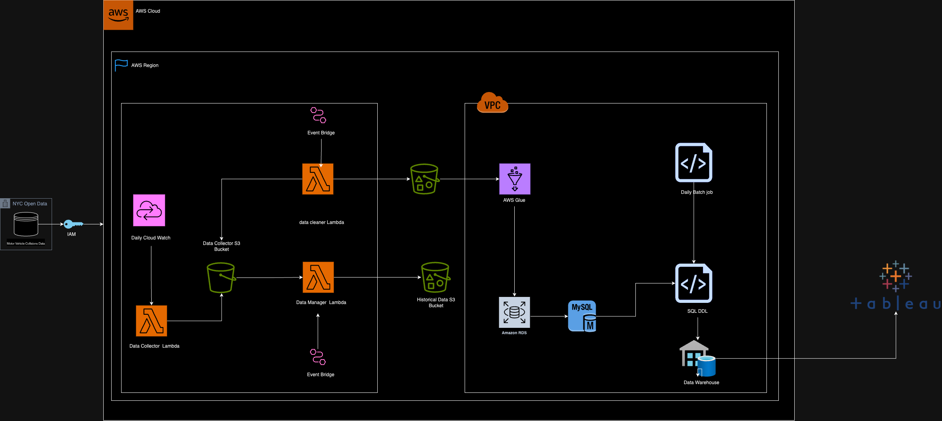
Project Architecture
Yeshiva University | Katz School

Slide 7
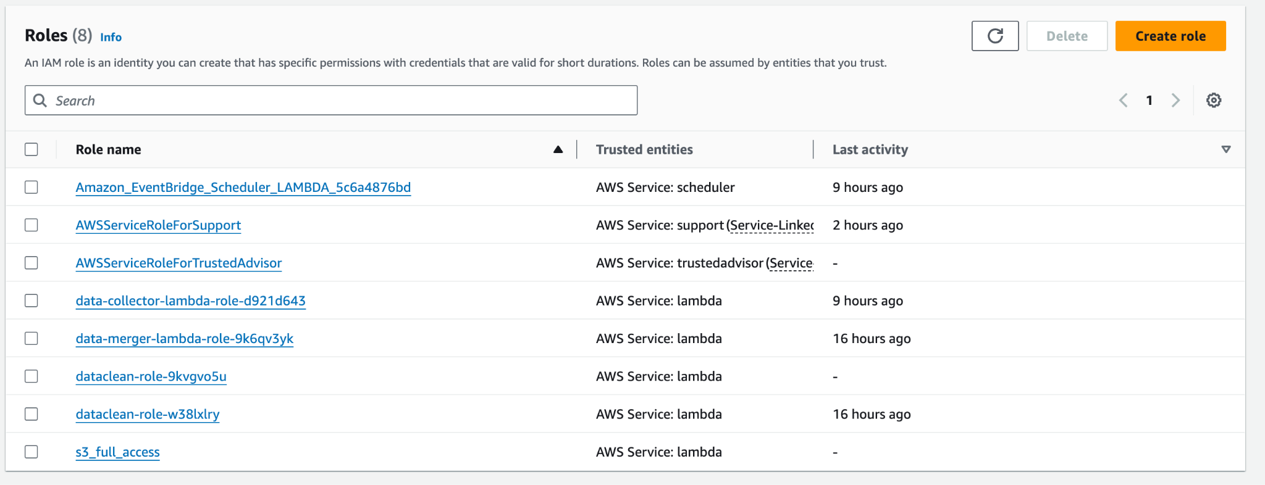
Policy and Roles details in IAM
Yeshiva University | Katz School

Slide 8

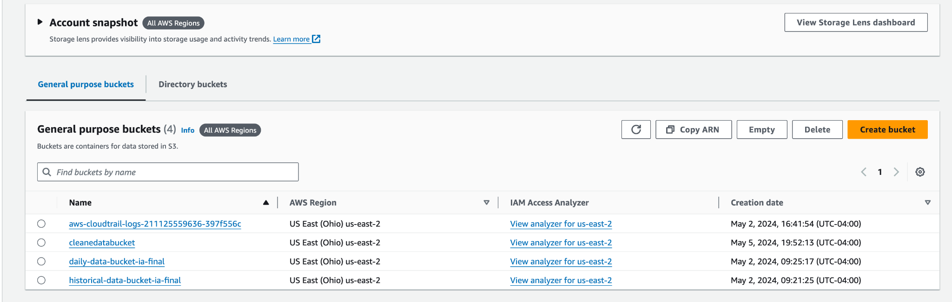
Created s3 Buckets to store and manage data
Yeshiva University | Katz School

Slide 9
Bucket Details
daily-data-bucket
Purpose: This bucket serves as the initial receiving point for daily data collections. It temporarily stores raw data files that are typically fetched from various data sources.
cleanedatabucket
Purpose: This bucket is used to store data that has been cleaned and processed by a Lambda function. This data is ready for further analysis or long-term storage.
historical-data-bucket-ia-final
Purpose: Acts as a long-term storage and archival bucket. This bucket holds historical data that is important for retrospective analysis and record-keeping.
Yeshiva University | Katz School

Slide 10
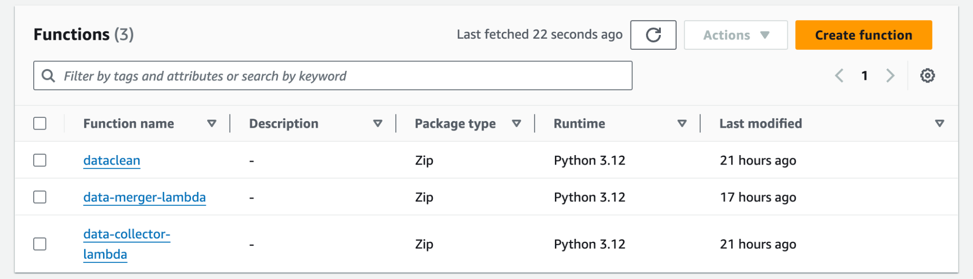
Lambda
Yeshiva University | Katz School

Slide 11
Lambda details
Data Collector Lambda (data-collector-lambda)
Purpose: This Lambda function is responsible for collecting data from crashes dataset API endpoints provided by the NYC OpenData project. It fetches fresh data regularly and stores it directly into daily-data-bucket S3 bucket.
Data Cleaner Lambda (data-cleaner-lambda)
Purpose: This function cleans the raw data collected by the Data Collector Lambda, preparing it for analysis and storage.
Data Manager Lambda (data-merger-lambda)
Purpose: This Lambda is designed to organize and archive data by moving processed data to appropriate locations and maintaining clean directory structures in the S3 buckets.
Yeshiva University | Katz School

Slide 12


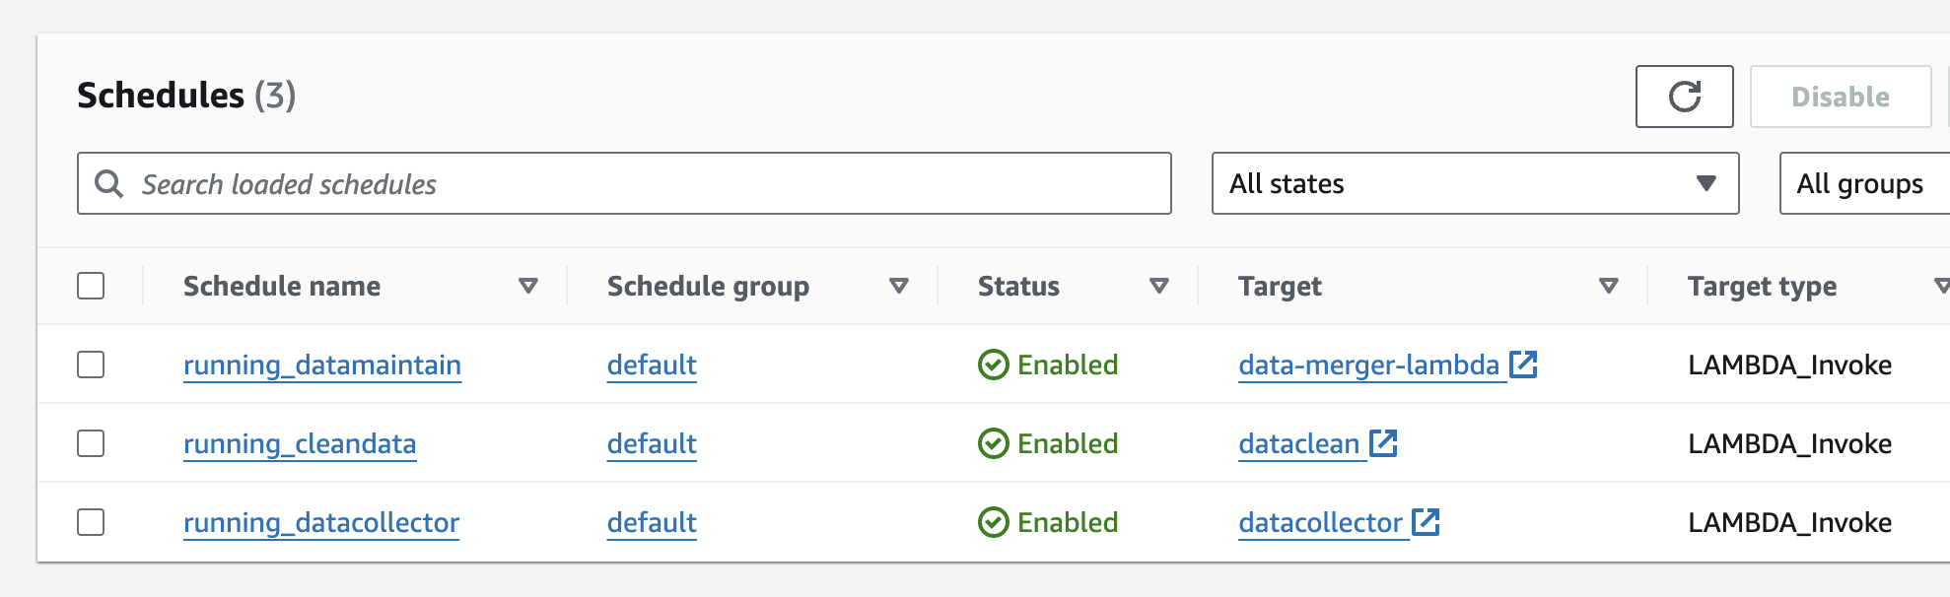
Event schedulers
Yeshiva University | Katz School

Slide 13
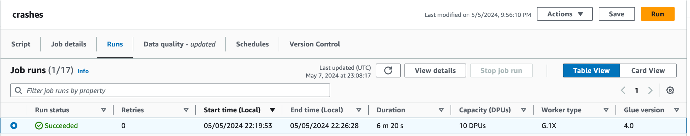
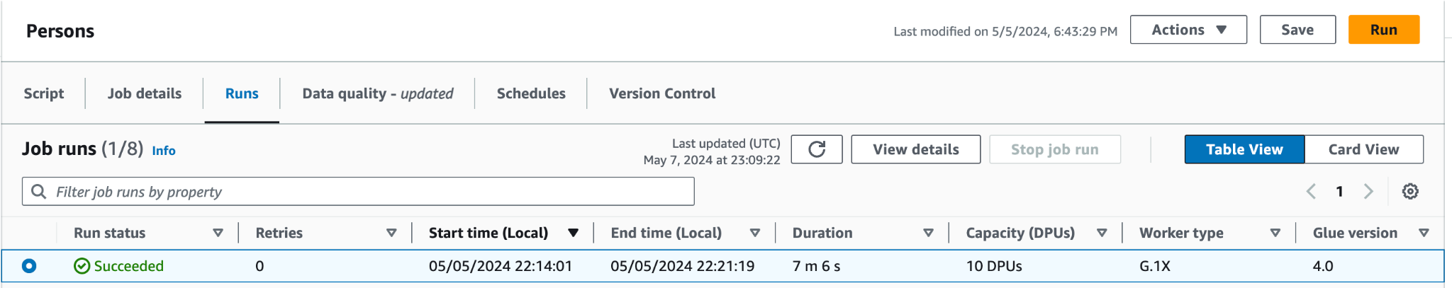

AWS Glue to Extract the data from s3 and pushing to RDS
Yeshiva University | Katz School

Slide 14

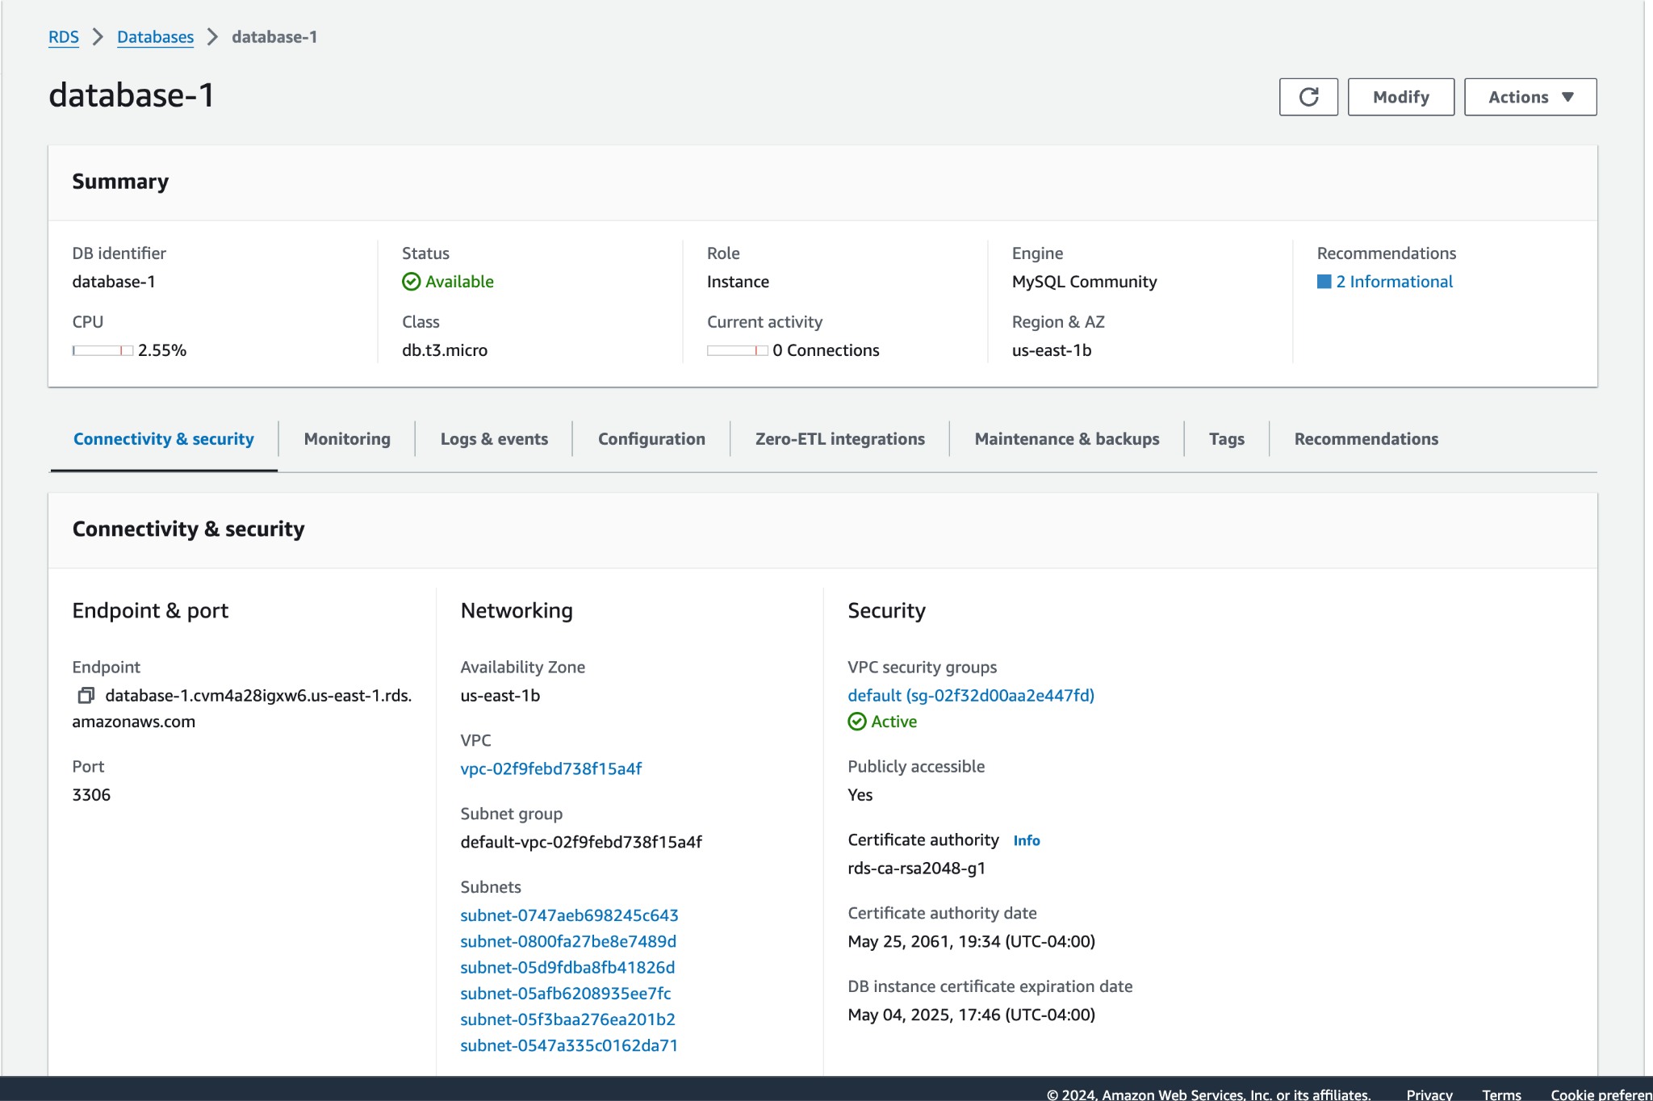
RDS to setup crashes Database and traffic data warehouse
Yeshiva University | Katz School

Slide 15
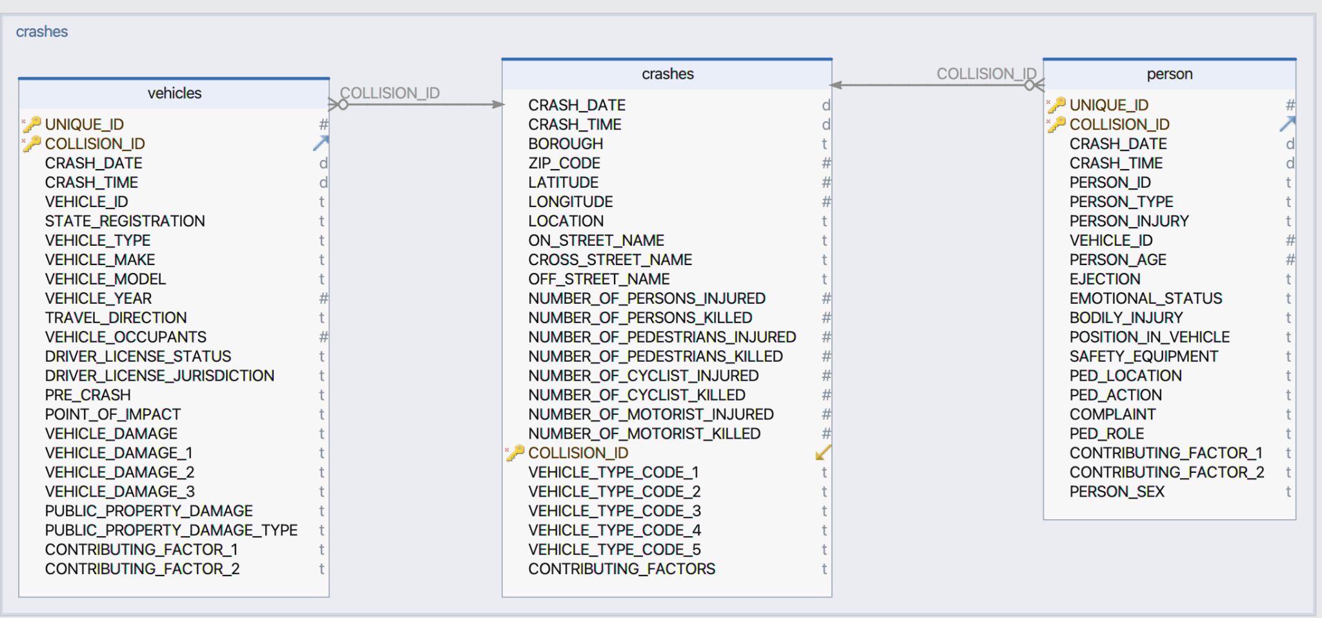
Source DB(Crashes_data) DB Schema
Yeshiva University | Katz School

Slide 16
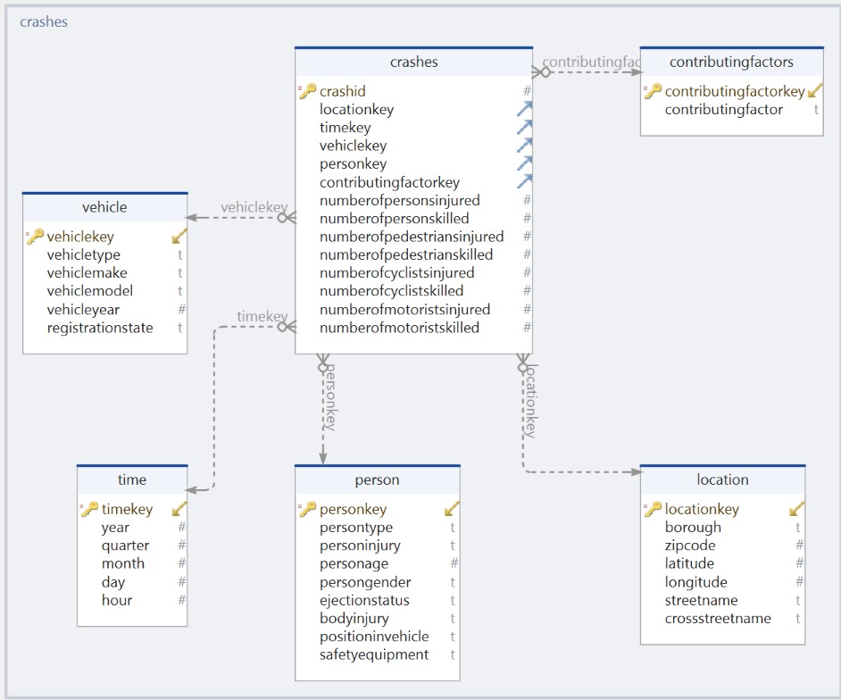
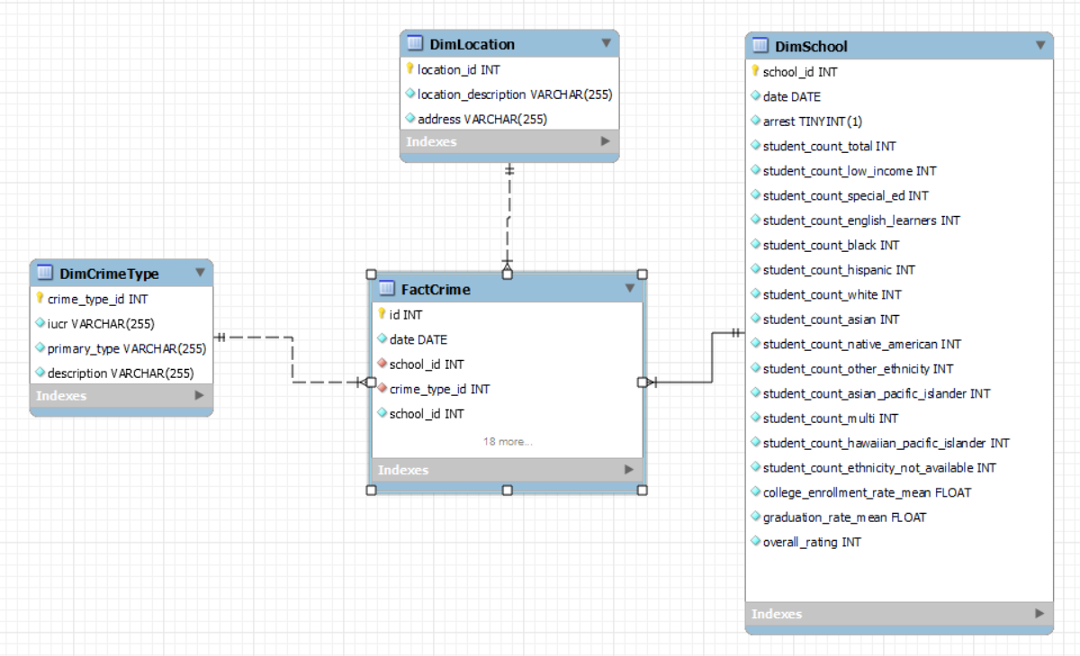
Dimensional Model
Yeshiva University | Katz School

Slide 17
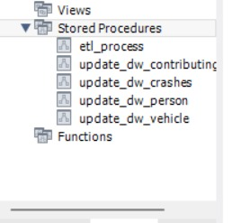
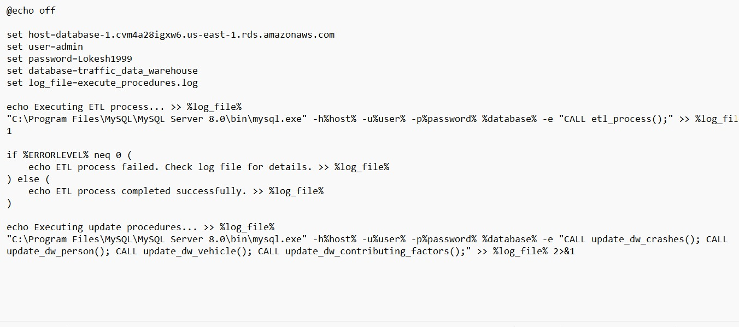
Batch job’s and stored procedures
Yeshiva University | Katz School

Slide 18

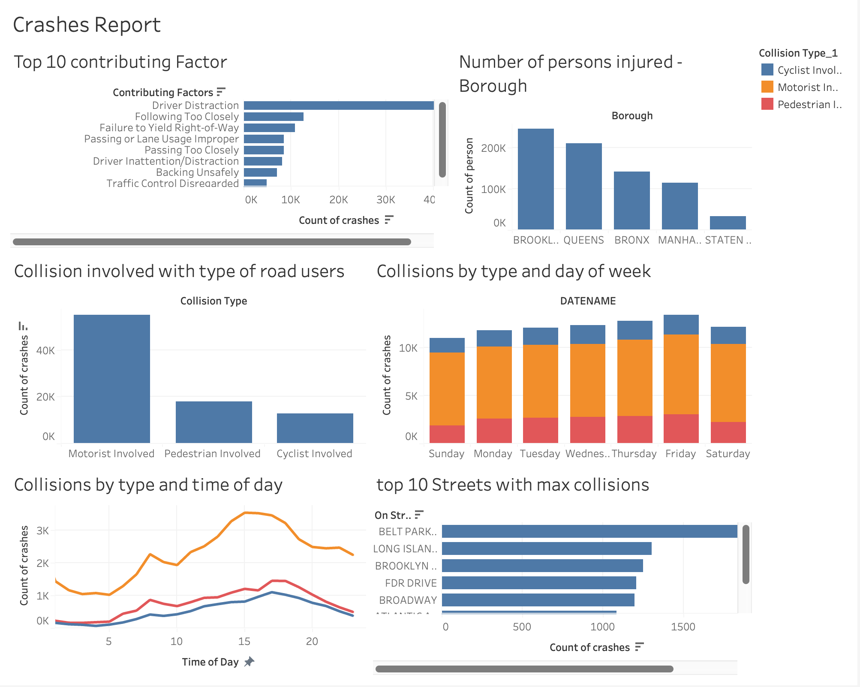
Reporting & Visualization
Yeshiva University | Katz School

Slide 19
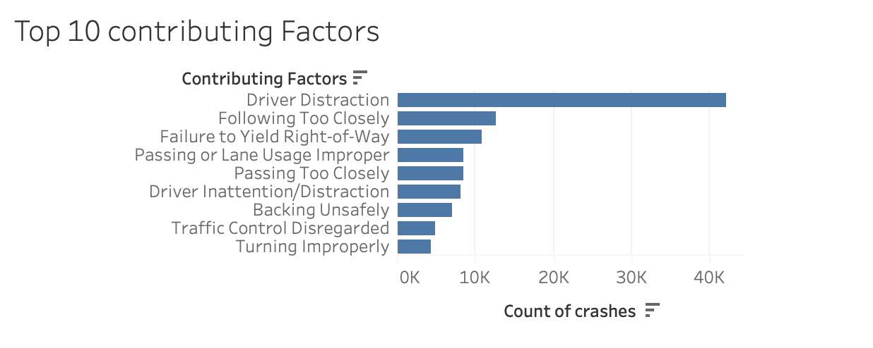
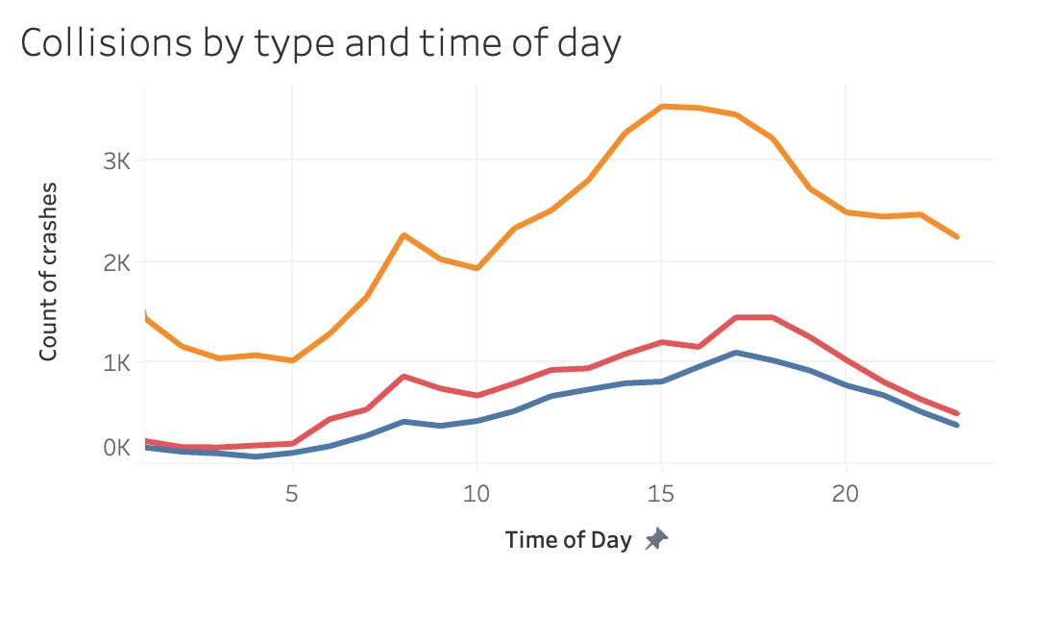
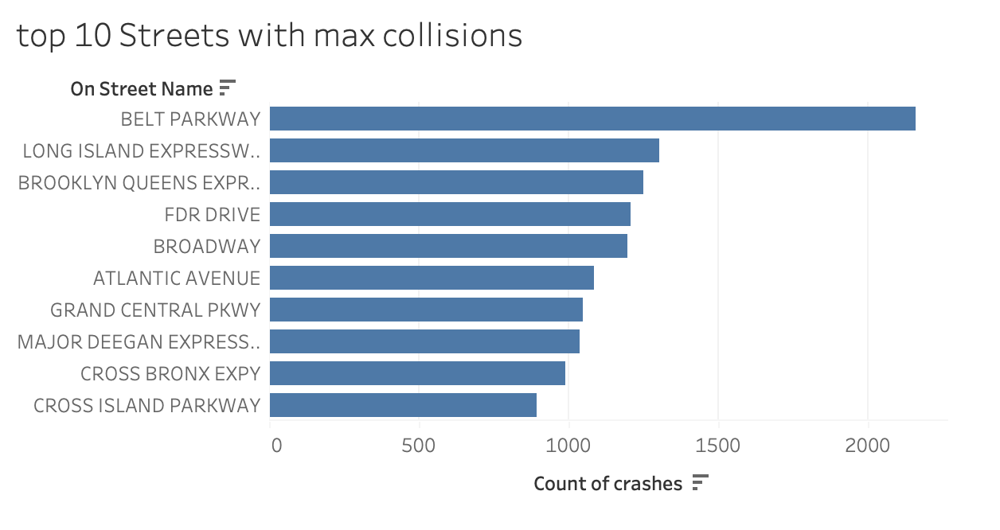
Yeshiva University | Katz School

Slide 20
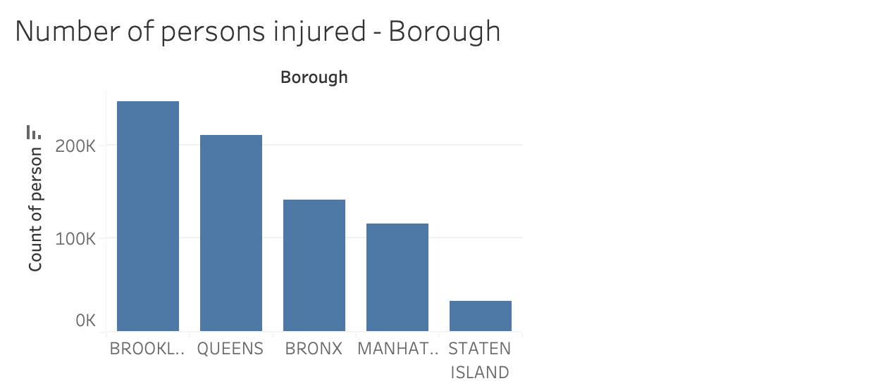
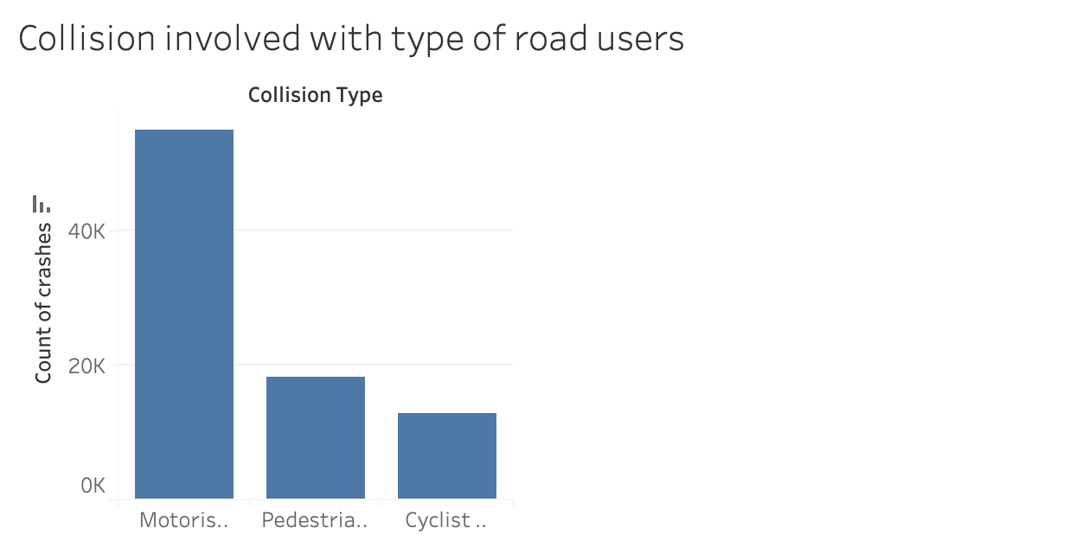
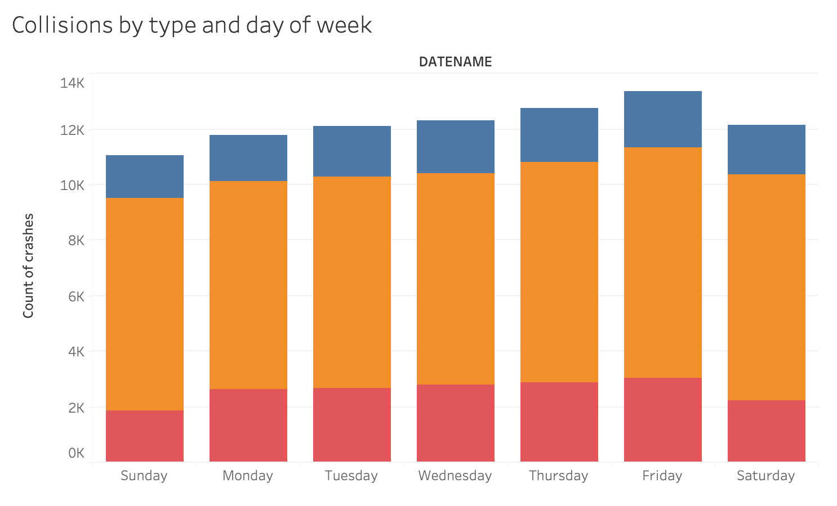
Yeshiva University | Katz School

Slide 21
Research questions
Research Question 1: Which borough in New York City has the highest number of persons injured due to motor vehicle collisions? Answer: According to the bar chart, Brooklyn has the highest number of persons injured due to motor vehicle collisions among the boroughs shown.
Research Question 2: How do the number of collisions involving different types of road users (motorists, pedestrians, and cyclists) compare?
Answer: The bar chart shows that collisions involving motorists are the highest, followed by pedestrians, and then cyclists.
Research Question 3: Which day of the week has the highest number of collisions in New York City?
Answer: Based on the stacked bar chart, Friday has the highest total number of collisions across the different collision types shown. Research Question 4: What are the top 3 contributing factors leading to motor vehicle collisions in New York City?
Answer: According to the bar chart, the top 3 contributing factors are Driver Distraction, Following Too Closely, and Failure to Yield Right-of-Way.
Research Question 5: Which street in New York City has the highest number of motor vehicle collisions?
Answer: The Belt Parkway has the highest number of collisions among the top 10 streets shown in the bar chart.
Research Question 6: How does the frequency of collisions vary throughout the day in New York City?
Answer: The line chart shows that the number of collisions peaks during the evening rush hour, around 5-6 PM, and then gradually decreases overnight, with the lowest number of collisions occurring in the early morning hours.
Yeshiva University | Katz School

Slide 22
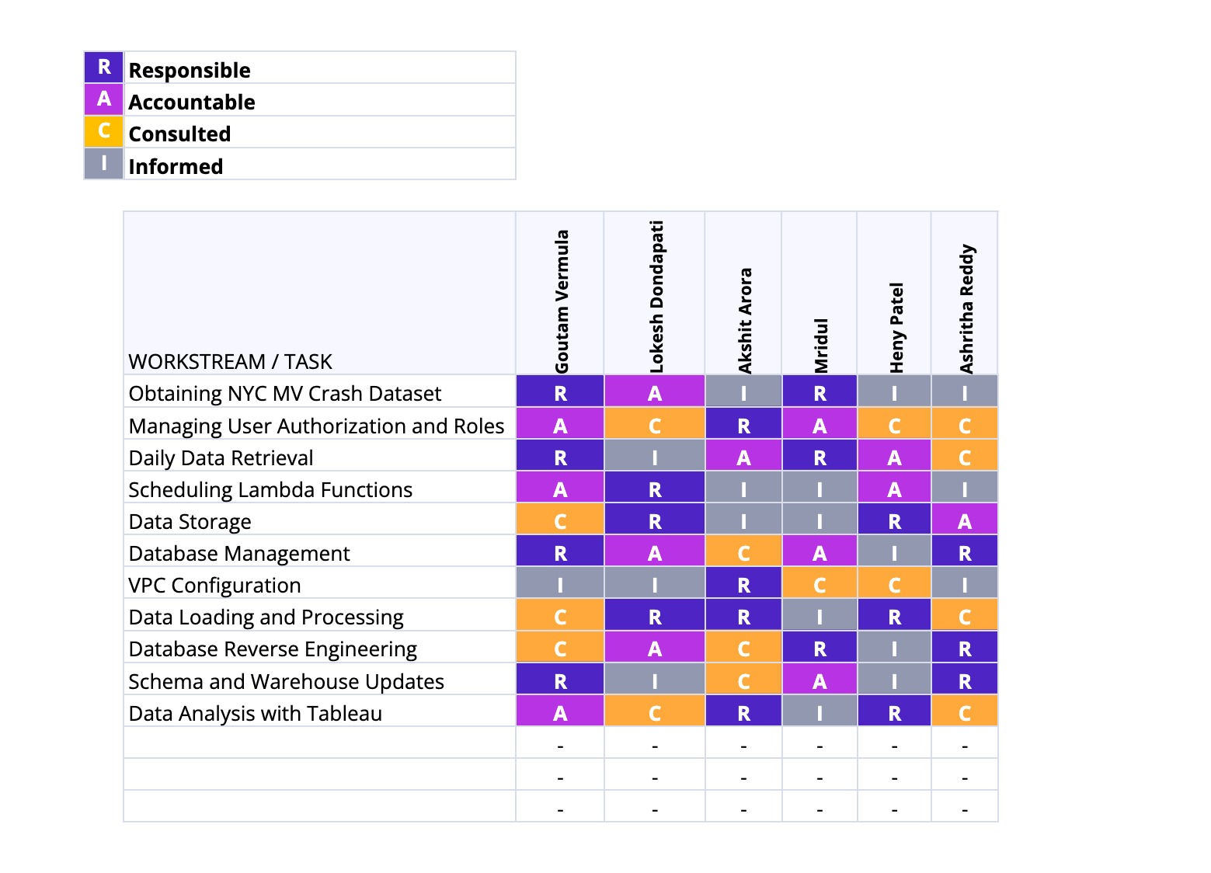
Team responsibilities and timeline
Yeshiva University | Katz School

Slide 23


